Slide 1
AWS Virtual Learning Series
March 2022

Slide 2
Agenda Day 2
Day 2 - 29 March
ML Intro 18:00 - 18:30
ML Demo 18:30 - 19:30
Environment Help 19:30 – 21:00
Day 3 - 1 April
Tech Challenge 18:00 – 21:00

Slide 3
Introduction to
Machine Learning with AWS
Presented by David Parker, ML Cloud Engineer

Slide 4

Poll
What is the difference between Machine Learning and Deep Learning?

Slide 5
What is it?
Artificial intelligence (AI)
Any technique that enables computers to mimic human intelligence using logic, if-then statements, and machine learning (including deep learning)
Machine learning (ML)
A subset of AI that uses machines to search for patterns in data to build logic models automatically
Deep learning (DL)
A subset of ML composed of deeply multi-layered neural networks that perform tasks like speech and image recognition
Notes:
You’ve probably heard these technologies described in a number of ways, so let’s take a step back to talk about what they are.
AI is a way to describe any system that can replicate tasks that previously required human intelligence.
This is almost always related to some kind of complex decision-making where human judgment is required. Most AI use cases are looking for a probabilistic outcome—making a prediction or decision with a high degree of certainty, similar to human judgement.
Almost all AI systems today are created using machine learning. Machine learning uses large amounts of data to create and validate decision logic, which is known as a model. The AI application then feeds input data into that model, and the model outputs human-like decisions. So machine learning is the underlying technology powering intelligent systems.
Finally, deep learning is a type of machine learning that uses a technique known as deep neural networks. These systems replicate how the human brain functions, which allows those systems to address more complex use cases than was previously possible.
Transition: Now that we have a better understanding of what is AI, let’s have a look at its business impact

Slide 6

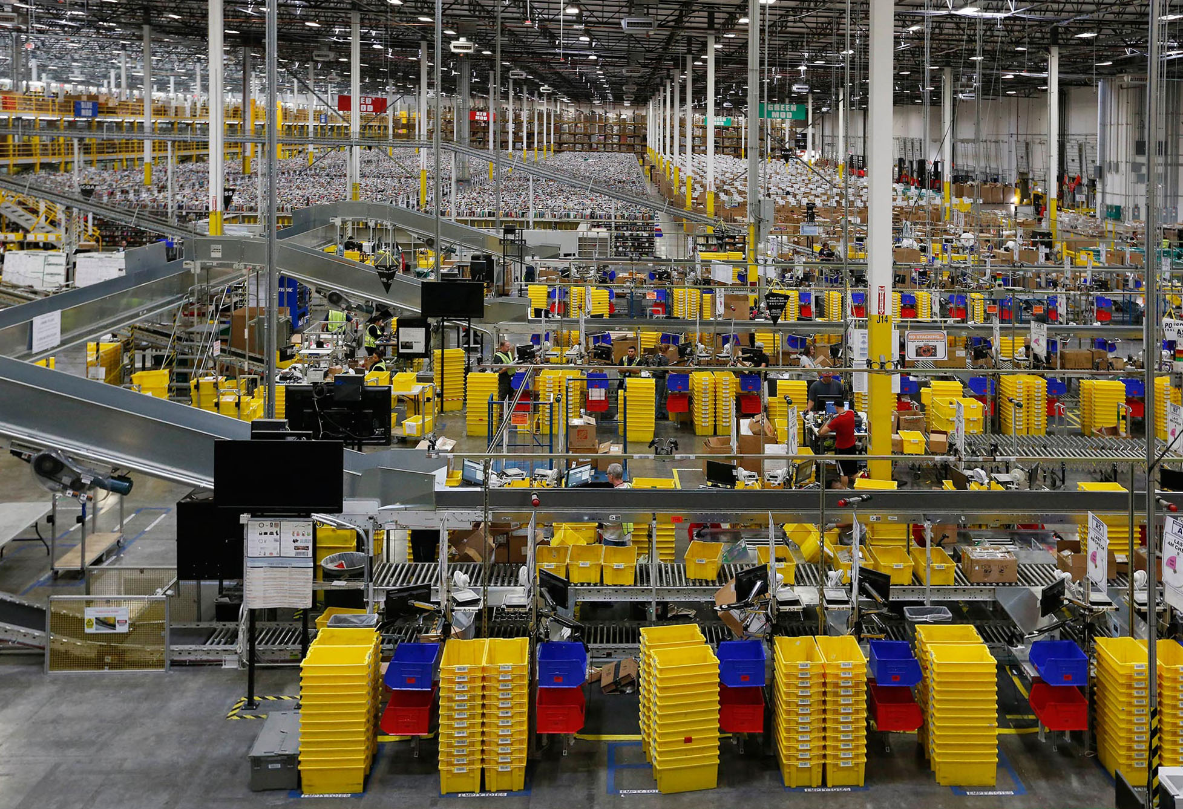
Amazon machine learning innovation at scale
4,000 products per minute sold on Amazon.com
1.6M packages every day
Billions of Alexa interactions each week
First Prime Air delivery on December 7, 2016
Notes:
ML is an integral part of Amazon. We have been applying ML in areas such as personalization and supply chain for more than 20 years.
We’ve also improved that original personalization model significantly over time and moved it to other products, such as Amazon Prime.
We use ML throughout our fulfillment process, including developing a forecast system that can predict the appropriate amount of demand for each product we sell worldwide to deliver on customer expectations for convenience, cost, and delivery speed.
We’ve developed natural language processing technology to give customers an entirely new way to interact with technology through Alexa.
We’ve also developed groundbreaking technology, such as autonomous flight through Prime Air drones and robotics in our fulfillment center to get packages to customers faster.
Almost every department at Amazon has been touched by machine learning.

Slide 7





















The AWS ML Stack Broadest and most complete set of machine learning capabilities
AI SERVICES
HEALTH AI
INDUSTRIAL AI
ANOMALY DETECTION
CODE AND DEVOPS
NEW
Amazon HealthLake
Amazon Transcribe for Medical
Amazon Comprehend for Medical
NEW
AWS Panorama + Appliance
NEW
Amazon Monitron
NEW
Amazon Lookout for Equipment
NEW
Amazon Lookout for Vision
NEW
Amazon Lookout for Metrics
NEW
Amazon DevOps Guru
Amazon CodeGuru
 | VISION | SPEECH | TEXT | SEARCH | CHATBOTS | PERSONALIZATION | FORECASTING | FRAUD | CONTACT CENTERS
Amazon Rekognition
Amazon Polly
Amazon Transcribe
+Medical
Amazon Comprehend
+Medical
Amazon Translate
Amazon Textract
Amazon Kendra
Amazon Lex
Amazon Personalize
Amazon Forecast
Contact Lens
Amazon Fraud Detector
Voice ID
For Amazon Connect
ML SERVICES
SAGEMAKER STUDIO IDE
Label data | NEW Aggregate & prepare data | NEW Store & share features | Auto ML | Spark/R | NEW Detect bias | Visualize in notebooks | Pick algorithm | Train models | Tune parameters | NEW Debug & profile | Deploy in production | Manage & monitor | NEW CI/CD | Human review
Amazon SageMaker
NEW: SageMaker JumpStart
NEW: Model management for edge devices
FRAMEWORKS & INFRASTRUCTURE
Deep Learning AMIs & Containers | GPUs & CPUs | Elastic Inference | Trainium | Inferentia | FPGA
DeepGraphLibrary
Notes:
Speaker Notes
1/ As you know, AWS offers builders with the right tools for the right job and provides them their choice of tools.
2/ When it comes to AI & Machine Learning, AWS offers a broad and deep set of services and supporting cloud infrastructure so that we can put machine learning in the hands of every developer, data scientist and expert practitioner.
3/ SageMaker is the middle of our 3-tier stack, and is intended for anyone who is looking to build, train, and deploy their own custom machine learning models.
Speaker Guidance
This slide should be presented quickly. By the time you are delivering this presentation to your audience, you should know that they want to specifically dive deep into SageMaker.

Slide 8
Amazon SageMaker
Build, train, and deploy machine learning (ML) models for any use case with fully managed infrastructure, tools, and workflows

Slide 9
Three Target Users for Amazon SageMaker
Business Analyists
Data Scientists
MLOps Engineers
Build ML Models and get predictions without writing code or understanding the nitty-gritty of data science
A full suite of tools to enable Data Scientists to do their work faster and in the most pain-free way
A selection of tools to allow CI/CD and model scaling to be simple and reduce model management overhead.

Slide 10
Amazon SageMaker brings tools for every step of the ML lifecycle under one unified visual user interface
SageMaker Studio | RSTudio
Label data
Prepare data
Store features
Detect bias
Build with notebooks
Train models
Tune parameters
Deploy in production
Explain predictions
Manage and monitor
Manage edge devices

Slide 11
Single visual interface for common data prep techniques
Select data from multiple sources
300+ built-in transformations to prepare data without writing code
Prepare Structured Data Organized, quantitative and easily decipherable by machine learning
Store features online and off-line
Store feature with a single click, update existing features or create new features
Consistent features, visual search and discovery
Features never get out of sync between training and inference
Visual search, sharing and collaboration
Share features into the repository promoting reuse and eliminating rework
Notes:
There are two types of data: structured and unstructured.
Structured data is highly organized, quantitative data that is easily decipherable by machine learning. However, structured data makes up only a small percentage of all the data out there.
Unstructured data on the other hand is 80% of all data. This data is qualitative including things like images, hand-written notes, and geospatial data. It’s extremely valuable, but much harder to work with in the context of machine learning.
We’ve spent a lot of energy on making data prep for all types of data better for our customers. Let’s look at the tools for structured data.
1/ We launched SageMaker Data Wrangler to easily aggregate and prepare data for machine learning without writing any code. With Data Wrangler, you can use a visual interface to access, cleanse, and explore data from a single visual interface.
2/ Using SageMaker Data Wrangler’s data selection tool, you can choose the data you want from various data sources and import it with a single click.
3/ SageMaker Data Wrangler contains over 300 built-in common data transformations so you can quickly normalize, transform, and combine features without having to write any code such as converting data types to a consistent format or formatting strings. With SageMaker Data Wrangler’s visualization templates, you can quickly preview and inspect that transformations are completed as you intended.
4/ With SageMaker Data Wrangler, data scientists can easily prepare structured data for ML including model features. Features represent relevant attributes or properties that your model uses for training and to make predictions. Selecting which features your model will use for predictions is a high judgement call requiring data scientists to apply domain knowledge to extract features from raw data. These features are then used to train a model and used in inference, when the model is making a prediction.
5/ All features created in Amazon SageMaker Data Wrangler can be stored in Amazon SageMaker Feature Store with a single click, and it’s easy to update existing features or create new features.
6/ Amazon SageMaker Feature Store serves features in large batches for model training and also serves features with single digit millisecond latency for inference at run time.
7/ Because SageMaker Feature Store offers a central repository for model features, you have a consistent view of your features, in other words the exact same features are available for training and inference, so your features never get out of sync between training and inference.
8/ You can visually search and discover features in SageMaker Studio.
9/ All members of your team can share features into the repository promoting reuse and eliminating rework. Feature Store also offers a unified set of features definitions across teams making it easier for teams to work together.
Now let’s look at customer examples of Invista using Data Wrangler for data preparation and The Climate Corporation, using Amazon SageMaker Feature Store.

Slide 12
Data Wrangler
A tool for reading structured data, then performing transformations to add features and analyze their impact.
Transformations may be exported as processing jobs or python code, which leverages spark and pandas for many transformations.
Data may be exported to S3 or SageMaker Feature Store for sharing with other teams

Slide 13
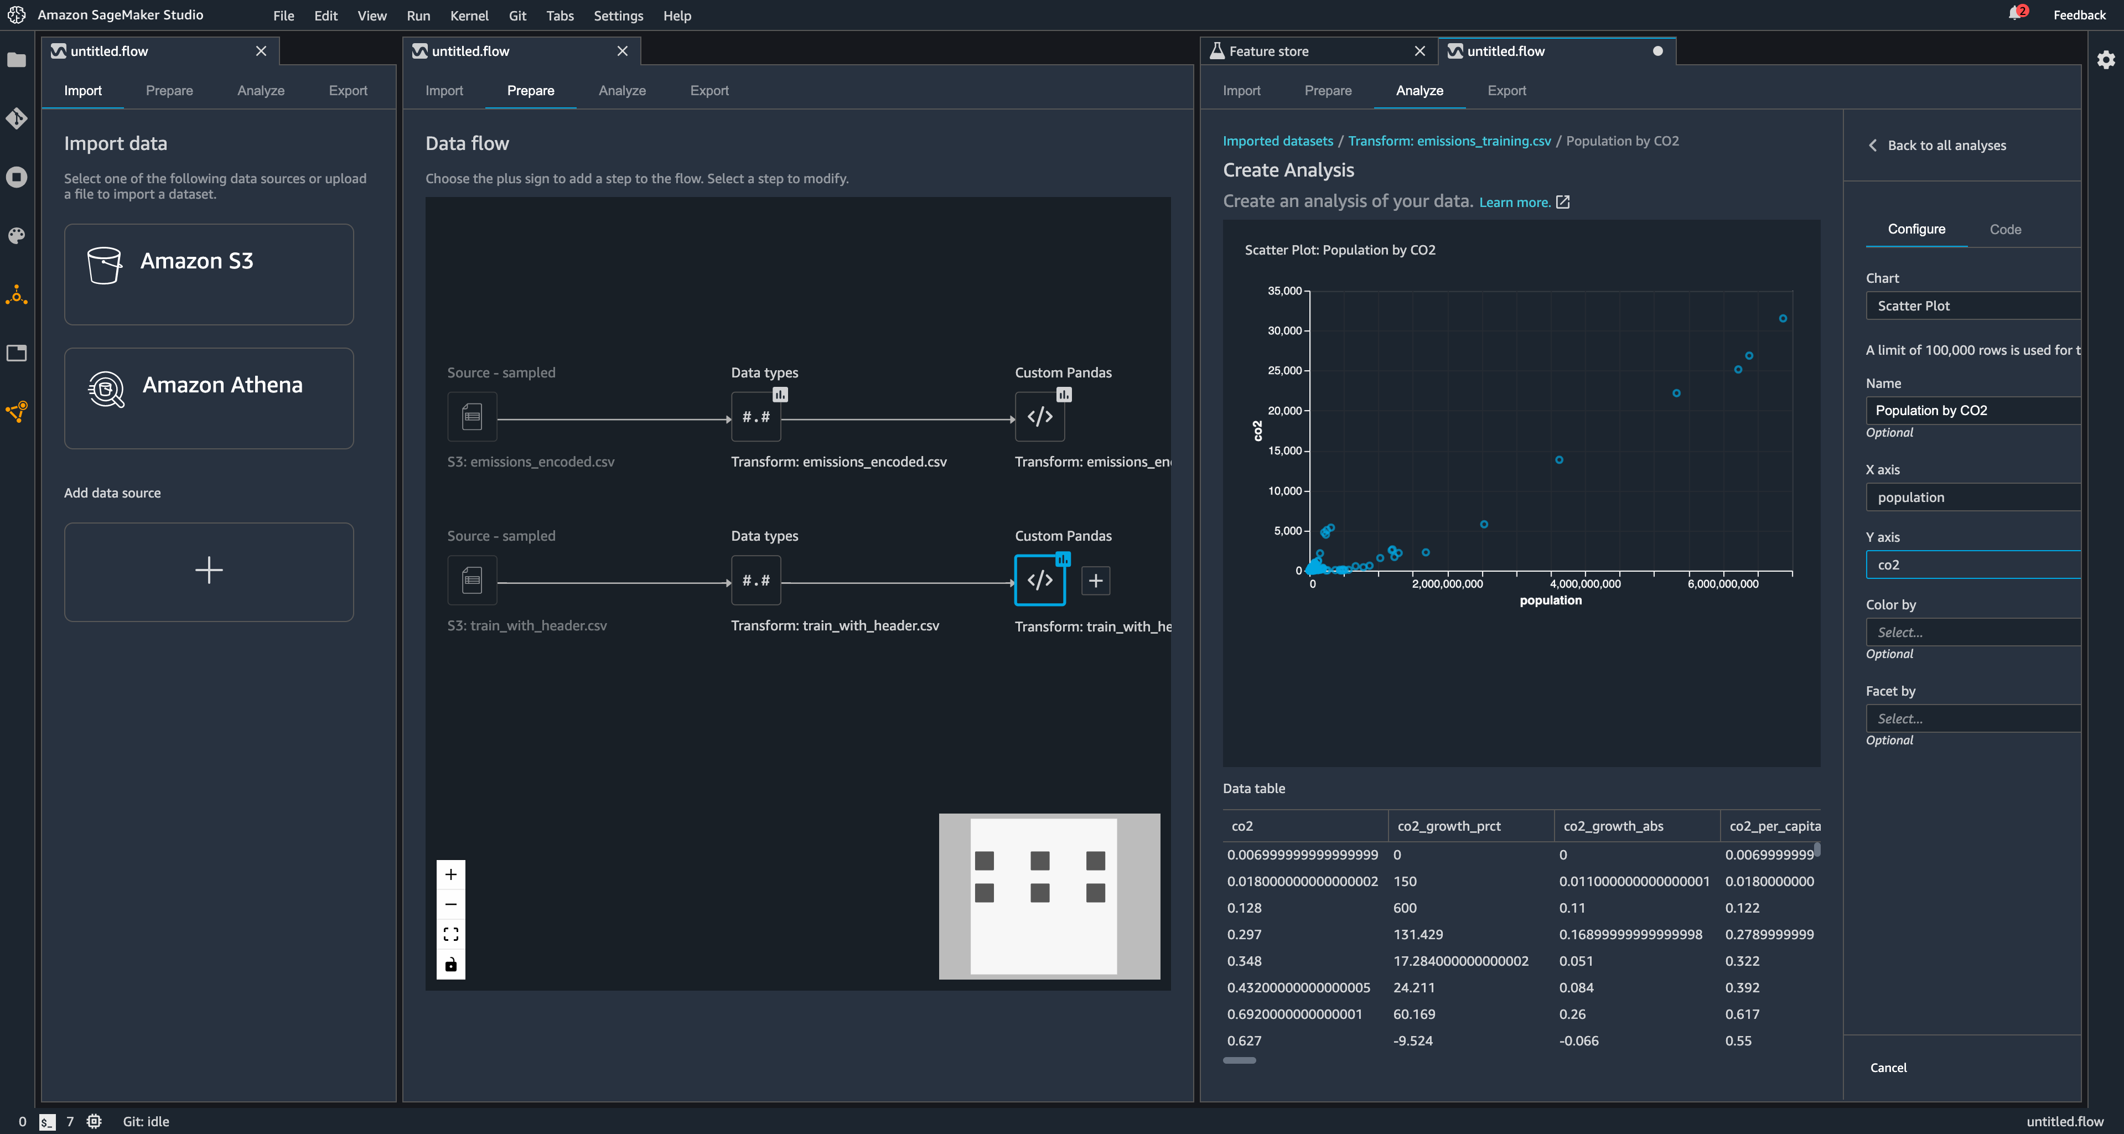
Amazon SageMaker Data Wrangler

Slide 14
Unlabeled data
Prepare data and tool engineering
Prepare Unstructured Data Qualitative things like images, hand-written notes, and geospatial data
Set up workflow and Manage workforce
Process improvement and Manage quality
Package labels
High-quality labels
Notes:
1/Since the introduction of SageMaker Ground Truth in 2018, data scientists have been using the 30+ pre-built workflows, 100+ templates, and multiple workforce options provided by the service to easily create high-quality training datasets. For instance, the NFL used Amazon SageMaker Ground Truth to reduce the timeline for developing a high quality labeling dataset by more than 80%.
2/But as ML adoption grows, labeling needs are increasing, which forces data scientists to spend weeks building data labeling workflows and managing labelers instead of focusing on model building, which slows down innovation and increases costs.
3/To ensure data scientists can spend their time building, training, and deploying ML models, customers typically task other in-house teams consisting of data operations and program managers to produce high-quality labeled data or outsource data labeling to a third-party partner.
4/However, data labeling partners often require high upfront costs and operate in silos without providing customers visibility into data labeling operations. Customers are looking for a labeling partner who will work with them to define data quality requirements and meet delivery service-level agreements, deliver high-quality labels, and reduce the cost per label.
5/To address this for customers, we have Amazon SageMaker Ground Truth Plus, a data labeling feature of Amazon SageMaker Ground Truth that enables you to easily create high-quality training datasets without having to build labeling applications and manage the labeling workforce on your own.
6/Amazon SageMaker Ground Truth Plus technical operations team takes care of data preparation, custom tooling development if required, managing labeling workflows and packaging labels so customers can directly use in their Machine learning jobs.
7/Amazon SageMaker Ground Truth Plus operations team takes care of project intake, policy management and updates and providing single point of contact for all customer interactions
8/Amazon SageMaker Ground Truth Plus delivery team takes care of project management, workforce training, quality management and process improvement
All these aspects of Amazon SageMaker Ground Truth Plus are transparent to customer hence require very little involvement from the customer.
Let’s review the customer example of Airbnb using Amazon SageMaker Ground Truth Plus for customized data labeling workflow.

Slide 15
SageMaker Ground Truth
Ground Truth is SageMaker’s solution to unstructured data.
Scalable Manual labelling integration to extract information from unstructured data, such as:
Images
Text
Video

Slide 16
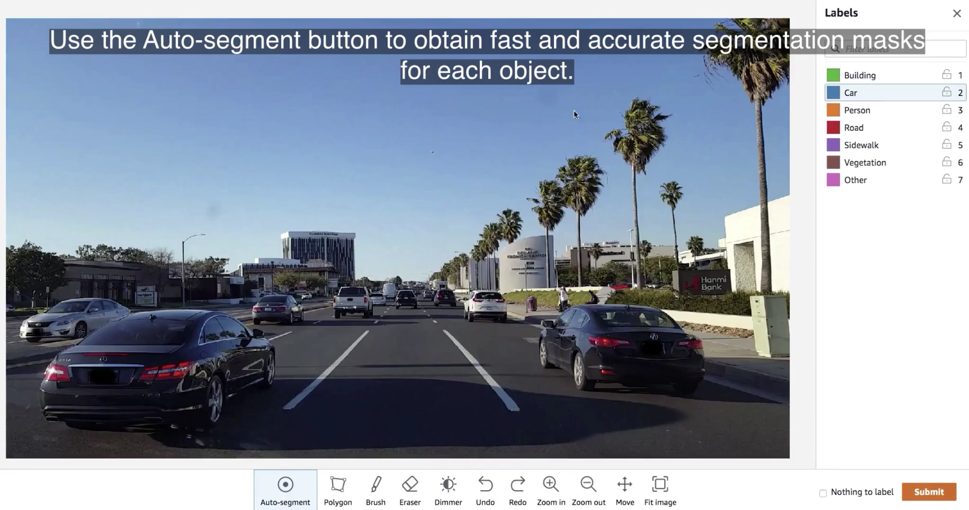
Automatic Data Labelling with SageMaker Ground Truth

Slide 17
Fully managed, sharable Jupyter notebooks
Run notebooks on elastic compute resources
Built-in algorithms
15 built-in algorithms available in prebuilt container images
Build ML models
Fully managed shareable notebooks on Amazon EC2
Prebuilt solutions and open-source models
Over 150 popular open-source models
AutoML
Automatically create ML models with full visibility
Support for major frameworks and toolkits
Optimized for popular deep learning (DL) frameworks such as TensorFlow, PyTorch, Apache MXNet, and Hugging Face
Notes:
Now that we have our data prepared, there are many different ways which one could go about building a model: 1. Using SM Studio notebook env (sharable with colleagues)
2. Using built-in algorithms
4. Jumpstart pre-built solutions + open source models
5. Automl
6. Using deep learning containers and building using major frameworks
Besides this, also accessible is SageMaker Marketplace where turnkey solutions are available from third parties.
1/Amazon SageMaker Studio provides all the tools you need to iteratively try different modeling techniques in order to evaluate their performance. You can pick different algorithms, including over 15 that are built in and optimized for SageMaker, and over 150 pre-built models from popular model zoos available with just a few clicks. Inside SageMaker Studio, you can run the models on a small scale to see results and view reports on their performance so you can come up with high-quality working prototypes.
2/The key capabilities for building ML models are:
Fully managed Jupyter Notebooks
Amazon SageMaker Studio Notebooks are fully managed Jupyter notebooks and the underlying compute resources are fully elastic, so you can easily dial up or down the available resources. Notebooks are shared with a single click so colleagues get the same notebook, saved in the same place.
Built-in Algorithms
Amazon SageMaker also offers over 15 built-in algorithms available in pre-built container images that can be used to quickly train and run inference. Some example algorithms include, DeepAR, K-Means Clustering, Linear Learn, K-Nearest Neighbor, and BlazingText.
Pre-Built Solutions and Open-Source Models
Amazon SageMaker JumpStart helps you quickly get started with ML using pre-built solutions that can be deployed with just a few clicks. SageMaker JumpStart also supports one-click deployment and fine-tuning of more than 150 popular open-source models.
AutoML
Amazon SageMaker Autopilot automatically builds, trains, and tunes the best machine learning models, based on your data while allowing to maintain full control and visibility. You then can directly deploy the model to production with just one click, or iterate to improve the model quality. Amazon SageMaker Autopilot eliminates the heavy lifting of building ML models, and helps you automatically build, train, and tune the best ML model based on your data. With SageMaker Autopilot, you simply provide a tabular dataset and select the target column to predict, which can be a number (such as a house price, called regression), or a category (such as spam/not spam, called classification). SageMaker Autopilot will automatically explore different solutions to find the best model. You then can directly deploy the model to production with just one click, or iterate on the recommended solutions with Amazon SageMaker Studio to further improve the model quality.
Optimized for Major Frameworks
Amazon SageMaker is optimized for many popular deep learning frameworks such as TensorFlow, Apache MXNet, PyTorch, and more. Frameworks are always up-to-date with the latest version, and are optimized for performance on AWS. You don’t need to manually setup these frameworks and can use them within the built-in containers.
Transition: Today, data scientists use SageMaker Studio to quickly spin up a Notebook in SageMaker Studio to build machine learning models. But, customers tell us that to get the most value from their data they often need to manage separate analytic and data preparation notebooks to perform data engineering and data analytics as well as for building machine learning models. And increasingly, the functions of data engineering, data analytics, and data science are blurring, either being performed by the same person or often needing access to the same tool sets. For instance, both an engineer and a scientist need to run some Spark workloads, be it for pre-processing or feature engineering or data exploration or perhaps even model building. The context switching and set up of different interfaces is complex and slows down innovation. To solve this, customers asked us for one notebook to cover all of their data needs.

Slide 18
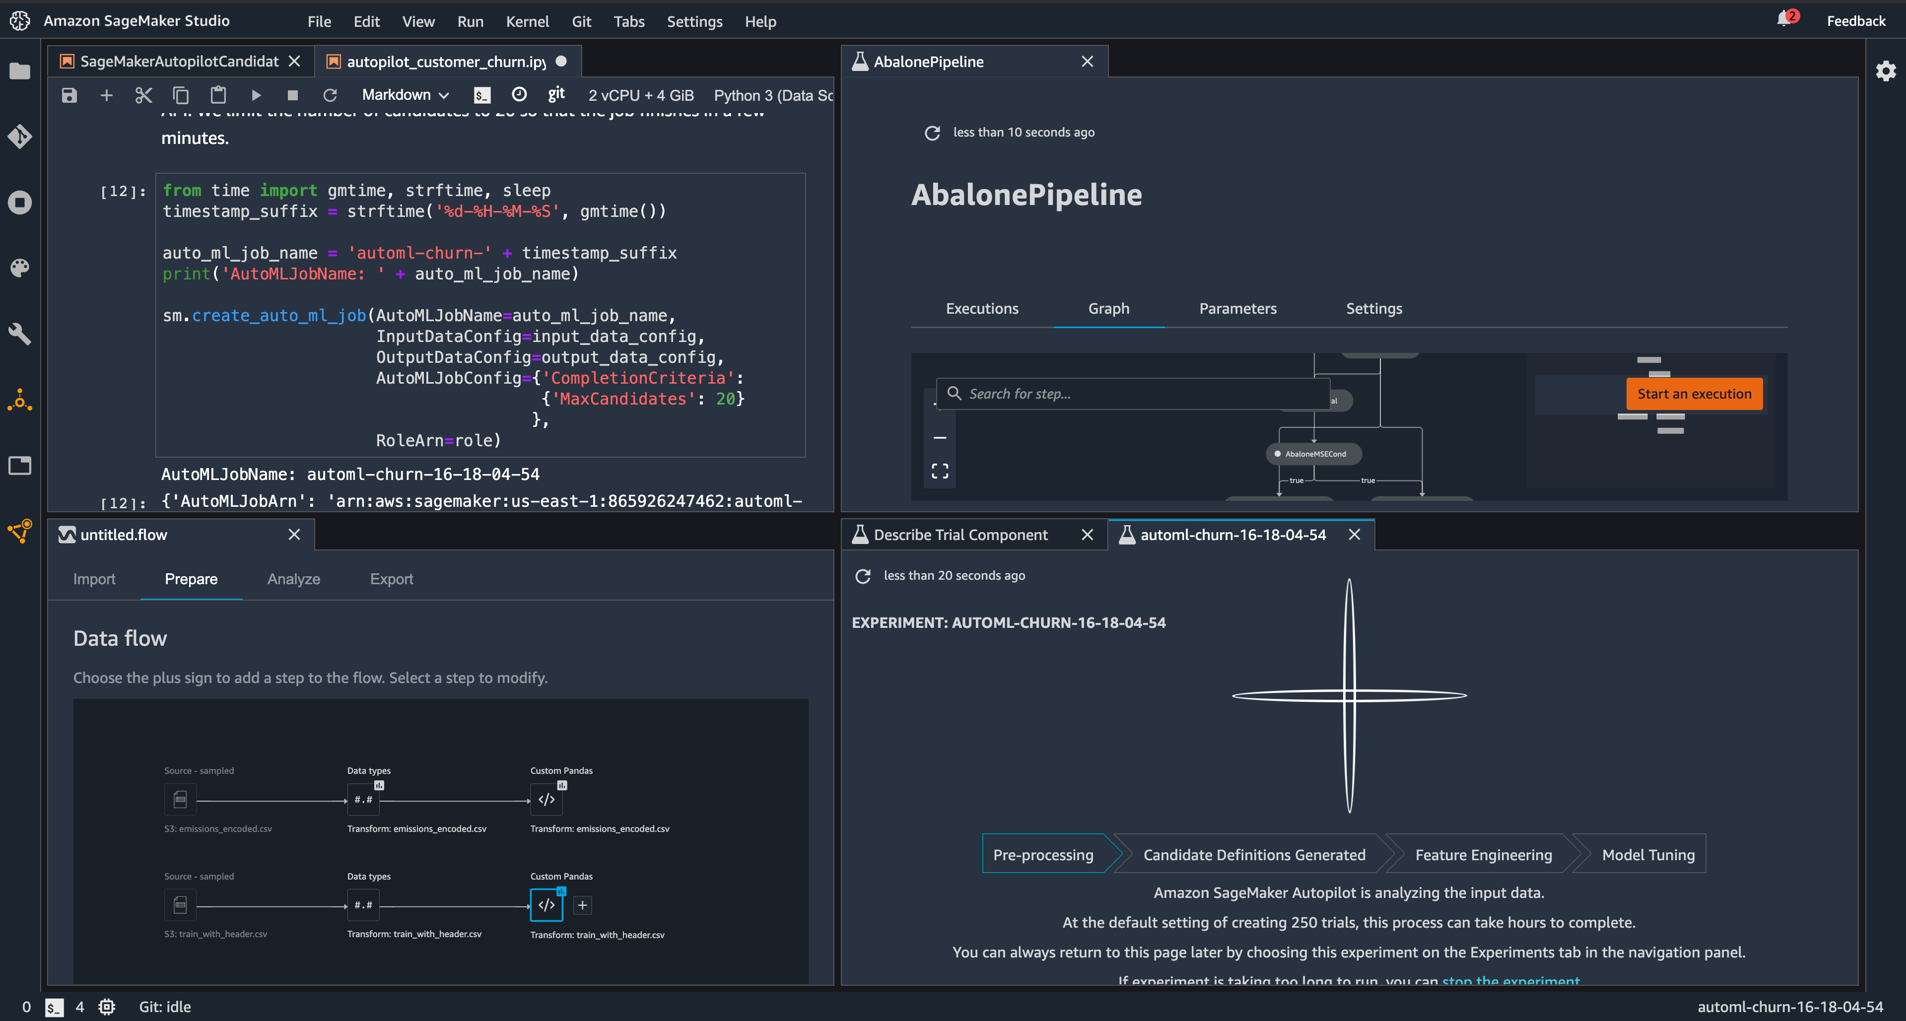
Amazon SageMaker Studio

Slide 19
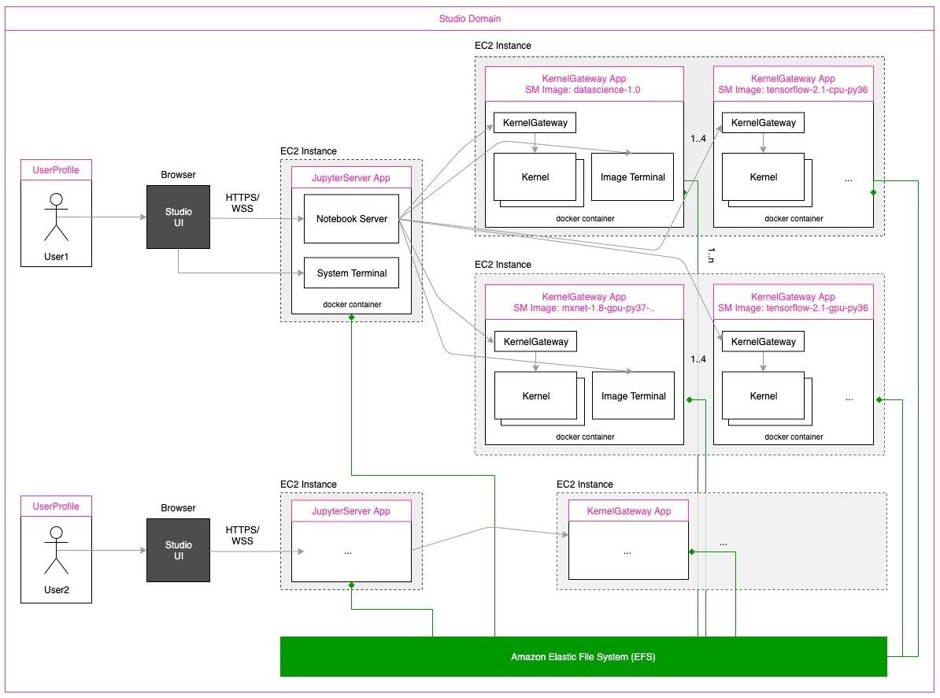
SageMaker Studio Architecture

Slide 20
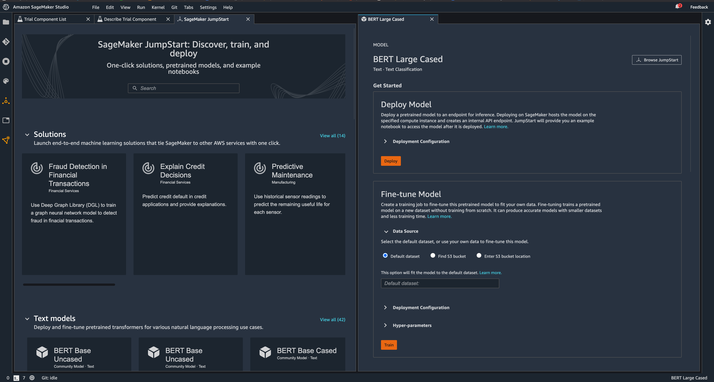
Search, Finetune, and Deploy with SageMaker JumpStart

Slide 21
Experiment management and model tuning
Save weeks of effort by automatically tracking training runs and tuning hyperparameters
Debug and profile training runs
Use real-time metrics to correct performance problems
Train ML models
Fast and cost-effective ML model training
Distributed training
Complete distributed training up to 40% faster
Training compiler
Accelerate training times by up to 50% through more efficient use of GPUs
Managed spot training
Reduce the costs of training by up to 90%
Notes:
1/ Amazon SageMaker reduces the time and cost to train and tune machine learning (ML) models without the need to manage infrastructure.
2/With Amazon SageMaker, you can easily train and tune ML models using purpose-built tools to manage and track training experiments, automatically choose the optimal hyperparameters, debug training jobs, and automatically monitor utilization of system resources such as GPUs, CPUs, and network bandwidth. All steps of the training workflow can be automated into ML workflow so you can scale to thousands of training experiments. SageMaker also offers the highest performing ML compute infrastructure including P4d instances which provide up to 60% lower cost to train ML models compared to previous generation instances. SageMaker automatically scales infrastructure up and down based on your training job requirements from one GPU to thousands, or from terabytes to petabytes of storage. Therefore, you don’t need to worry about managing infrastructure, and since you only pay for what you use, you can better manage your training costs. To making training faster, you can enable the SageMaker Training Compiler and immediately achieve up to 50% speed up through graph and kernel level optimizations which makes more efficient use of GPUs. Also, the SageMaker distributed training libraries automatically split models and training datasets across GPU instances helping you complete distributed training up to 40% faster.
3/The key capabilities to train ML models are:
Experiment Management and Automatic Model Tuning
Amazon SageMaker Experiments helps you track iterations to ML models by capturing the input parameters, configurations, and results, and storing them as ‘experiments’. SageMaker can automatically tune your model by adjusting thousands of combinations of algorithm parameters to arrive at the most accurate predictions the model is capable of producing saving weeks of effort.
Debug and Profile Training Runs
Amazon SageMaker Debugger captures metrics and profiles training jobs in real-time so you can correct performance problems quickly before the model is deployed to production
Distributed Training
Amazon SageMaker makes it faster to perform distributed training by automatically splitting deep learning models and training datasets across AWS GPU instances with fewer than 10 lines of code.
Training Compiler
Amazon SageMaker Training Compiler accelerates training by up to 50% through graph and kernel level optimizations that make more efficient use of GPUs. It is integrated with the versions of TensorFlow and PyTorch in SageMaker so that you can speed up training in these popular frameworks with minimal code changes
Managed Spot Training
Amazon SageMaker provides Managed Spot Training to help you to reduce training costs by up to 90%. Training jobs are automatically run when compute capacity becomes available and are made resilient to interruptions caused by changes in capacity
Transition: Let’s now explore the capabilities and benefits of SageMaker for deploying ML models.

Slide 22
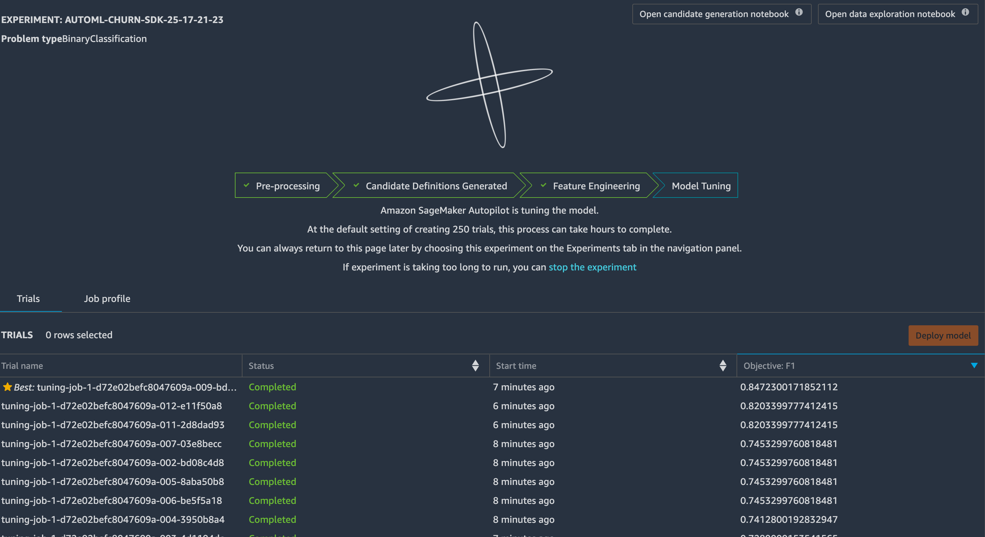
Train hundreds of models with SageMaker Autopilot

Slide 23
Each algorithm solves a type of prediction problem
Computer Vision
Topic Modeling
Classification
Linear Learner *
XGBoost *
KNN
Factorization Machines
Image Classification <>
LDA
NTM
Object Detection <>
Semantic Segmentation
Recommendation
Forecasting
Factorization Machines * (+ KNN)
DeepAR *
Working with Text
Blazing Text
Supervised
Unsupervised *
Clustering
Anomaly Detection
Random Cut Forests *
Kmeans *
KNN
IP Insights *
Feature Reduction
Sequence Translation
Regression
Linear Learner
XGBoost
KNN
PCA
Seq2Seq *
Object2Vec
* = distributed training
<> = incremental training

Slide 24
Many Ways to Train Models on Amazon SageMaker
1
2
3
Built-in Algorithms
Script Mode
Docker container
4
5
Locally*
In a pipeline

Slide 25
Poll
Which method would we use to that requires the least effort to bring our own algorithm?

Slide 26
Wide selection of infrastructure
70+ instance types with varying levels of compute and memory to meet the needs of every use case
Single-digit millisecond overhead latency
For use cases requiring real-time responses
Deploy ML models
Fully managed deployment for inference at scale
Asynchronous inference
Supports large models with long-running processing times
Cost-effective deployment
Multi-model/multi-container endpoints, serverless inference, and elastic scaling
Built-in integration for MLOps
ML workflows, CI/CD, lineage tracking, and catalog
Automatic deployment recommendations
Optimal instance type/count and container parameters, and fully managed load testing
Notes:
1/ Amazon SageMaker make it easy to deploy and manage machine learning models at scale. As a fully managed service, SageMaker takes care of setting up and managing instances for inference, ensuring software version compatibilities, and patching versions. SageMaker also provides built-in metrics and logs for endpoints that you can use to monitor and receive alerts.
2/Amazon SageMaker offers more than 70 instance types with varying levels of compute and memory, including Amazon EC2 Inf1 instances based on AWS Inferentia, high-performance ML inference chips designed and built by AWS, and GPU instances such as Amazon EC2 G4dn to meet the performance and cost requirements of any use case, including real-time, high throughput, and batch inference.
3/SageMaker allows developers to access deployed models through API requests with response times as low a few milliseconds. This supports use cases requiring real-time responses, such as ad serving, fraud detection, and personalized product recommendations.
4/For inference requests that take longer to finish, SageMaker offers asynchronous inference, which supports processing times up to 15 minutes and payloads up to 1 gigabyte. Asynchronous inference is best suited for use cases requiring real-time user experience, but use large CV or NLP models. With asynchronous inference, your inference requests get separated from your backend application and web servers to prevent long-running inference requests from blocking your calling application. Asynchronous inference can also scale your model serving instance count down to zero, optimizing your costs when you don't need to make inference requests.
5/SageMaker provides scalable and cost-effective ways to deploy ML models, whether it’s one model or a large number of models. SageMaker multi-model endpoints and multi-container endpoints enable you to deploy thousands of models on a single endpoint, improving cost-effectiveness while providing the flexibility to utilize models as often as you need them. For use cases with intermittent inference requests (long idle periods between inference requests), SageMaker Serverless Inference automatically provisions, scales, and turns off compute capacity based on the number of inference requests. SageMaker Serverless Inference, the service automatically removes the need to manage complex scaling workflows by ensuring the exact amount of resources are available for inference to save time and money. For all other use cases, you can use autoscaling in SageMaker policies to elastically scale the underlying compute resources to accommodate fluctuations in inference requests, while reducing cost.
6/SageMaker model deployment features are natively integrated with MLOps capabilities, including SageMaker Pipelines (workflow automation and orchestration) and SageMaker Projects (CI/CD for ML), SageMaker Feature Store (feature management), SageMaker Model Registry (model and artifact catalog to track lineage and support automated approval workflows), SageMaker Clarify (bias detection), and SageMaker Model Monitor (model and concept drift detection). As a result, deploying one model or tens of thousands of models, SageMaker helps offload the operational overhead of deploying, scaling, and managing ML models while also getting your models to production faster. SageMaker also allows you to implement advanced deployment capabilities for ML, such as A/B testing, canary, batch, and blue/green deployments. Using these techniques, data scientists can rapidly release model updates, avoid downtime during deployment, and benchmark the performance of their models in development, test, and production environments.
7/SageMaker Inference Recommender helps you automatically select the optimal compute instance and configuration (e.g. instance count, container parameters, and model optimizations) to deploy your machine learning models. SageMaker Inference Recommender reduces the time to deploy from weeks to hours by automatically recommending the ideal compute instance configuration and model optimizations. You can use SageMaker Inference Recommender to deploy the model to one of the recommended compute instances, or use the service to run a load test across a range of compute instance types you select. Load testing is fully managed so you don’t need to manage any testing infrastructure. You can review the benchmark results in SageMaker Studio and evaluate the tradeoffs between different configuration settings including latency, throughput, cost, CPU/GPU usage, and memory. SageMaker Inference Recommender allows you to optimize price performance of your inference workload.
Transition: Machine learning lifecycle doesn't stop there. Once models are deployed they need to be monitored for quality and performance and retrained when new data is available or the business and user dynamics change. So model development and deployment is not a one-and-done task. Handling the iterative nature of ML lifecycle requires ML operations (or MLOps) practices. That brings us to the next component of SageMaker.

Slide 27
Poll
In the context of AI, what is inference?

Slide 28
Inference with SageMaker
Inference – The process of using a trained machine learning algorithm to make a prediction.

Slide 29
SageMaker Inference Methods
On-demand endpoint – low latency:
Multi-model – like on demand, but with multiple models
Multi-container – supports pipelines and parallel containers
Serverless – on-demand but sagemaker manages capacity and scaling
Elastic Inference – network attach a GPU for cost savings
Batch transform – for batch scoring entire datasets at once
Asynchronous – near real-time, larger payloads and longer processing time by processing payloads from s3 onto s3.

Slide 30
SageMaker Endpoint Components
Model:
The results of the training job, a combination of the model object and the docker image in which this object will run.
Endpoint Configuration:
A defined configuration for how an endpoint should exist.
May have multiple models defined (eg A/B testing) and defines the instance types and scaling.
May be seen as a blueprint for an endpoint.
Endpoint:
The instantiation of an endpoint configuration.
Billed per instance per runtime

Slide 31
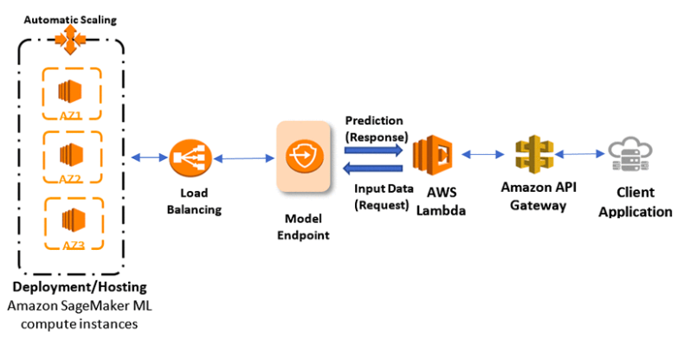
Automatically Create a RESTful API Around Your Model
model = Model(ecr_image_uri, s3_model_data)
predictor = model.deploy(3, ‘ml.m4.xlarge’)

Slide 32
Serve Thousands of Models with Multi-Model Endpoints
client.invoke_endpoint(
EndpointName = ‘my-endpoint’,
ContentType = ‘text/csv’
TargetModel = ‘model_1.tar.gz’,
Body = body)
EC2 Instance
Model_1
Hosting Image
Model_2
Model_3
client.invoke_endpoint(
TargetModel = ‘model_2.tar.gz’)
ECR
S3 Bucket
client.invoke_endpoint(
TargetModel = ‘model_3.tar.gz’)
Invoke the relative S3 path for your model, and SageMaker handles the rest

Slide 33
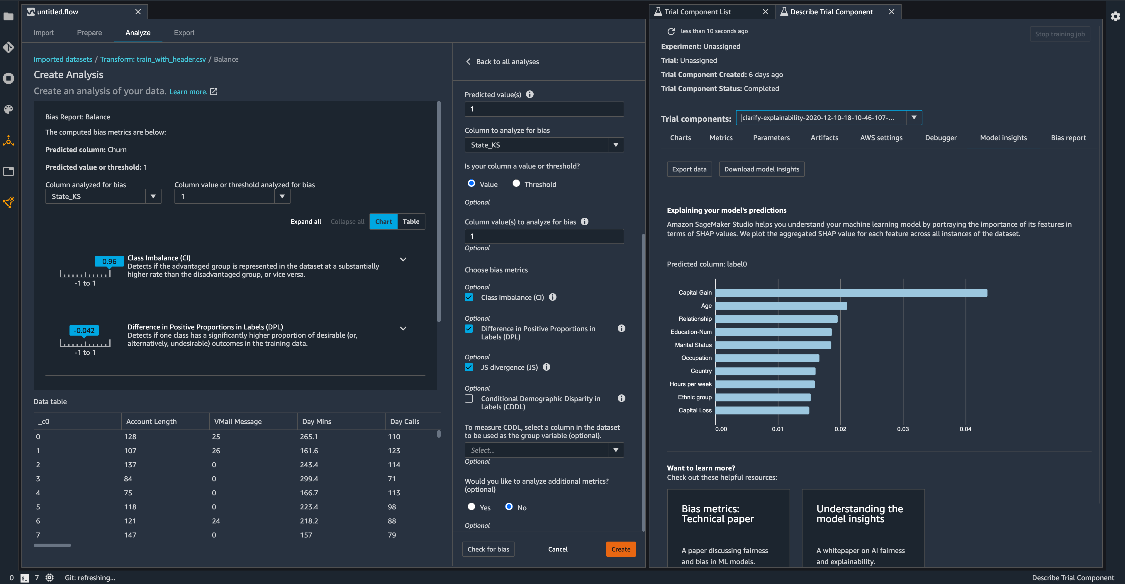
Analyze and Monitor Bias with Amazon SageMaker Clarify

Slide 34
Amazon SageMaker Studio Lab Learn and experiment with ML without the hassle
Learn
Quick and free access to a ML environment for hands-on tutorials, exercises, and labs
Teach
Spend more time preparing and teaching ML courses and less time troubleshooting ML environments
Train
Conduct workshops and training with less friction and setup time for participants
Collaborate
Conduct ML hackathons and challenges at scale with preconfigured environments and notebooks
Notes:
Lack of data science and machine learning talent slows down innovation.
Amazon SageMaker Studio Lab provides a simple no-cost environment for aspiring data scientists to experiment with machine learning.
Let’s review some of the features offered by Amazon SageMaker Studio Lab.

Slide 35

What is Amazon SageMaker Studio Lab?
→
Jupyter Notebook environment
Cost effective/easy setup
CPU/GPU compute
Time to code
Version control management
Supportive community
Full support of shell commands
Based on JupyterLab
Free—no setup
CPU (T3.Xl) & GPU (G4D.XL)
15 GBs to save projects
Integrated with Git
Integrated with Github
Terminal access
→
→
→
Amazon SageMaker Studio Lab
→
A no charge, no configuration service that andenable data scientists to learn experiment with machine learning
→
→
Notes:
SageMaker Studio Lab is ideal for users who do not need a production environment but still want a subset of the SageMaker Studio functionality to learn about ML.
SageMaker Studio Lab offers an open-source Jupyter-notebook environment integrated with GitHub and preconfigured with the most popular ML tools, frameworks, and libraries. As a result, you can write code immediately without the need to set up and configure infrastructure or manage identity and access.
SageMaker Studio Lab offers 15 GB of dedicated storage for your ML projects, and automatically saves your work so you don’t need to restart your project after each session ends. It’s as easy as closing your laptop and coming back later.
Transition: Let’s dive into the next component of Amazon SageMaker.

Slide 36
Resources
Machine Learning Home Page
https://aws.amazon.com/machine-learning/
SageMaker Home Page
https://aws.amazon.com/sagemaker/

Slide 37
Thanks!

Slide 38
Q & A

Slide 39
Machine Learning Demo Using SageMaker
Presented by Eddy Matungulu, ML Cloud Engineer

